Slide 1

Privatization in Banking Sector

Slide 2
Group Members
Aneri Sheth – 1401072
Hemil Gurjar – 1401002
Himanshu Budhia – 1401039
Janki Desai – 1401103
Kunal Suba – 1401097
Palash Hariyani – 1401101
Rajvi Prajapati – 1401033
Rupande Shastri - 1401102

Slide 3
Table of Contents
Introduction
Emergence of Private Sector Banks
Why Privatization?
Impacts of Privatization
Adverse Impacts of Privatization
Conclusion

Slide 4

Introduction
The private sector banks in India represent a growing, developmental part of the Indian banking sector.
The private sector banks are banks where greater parts of stake or equity are held by the private shareholders and not by government.
Some of the popular private sector banks are HDFC Bank, ICICI Bank, YES Bank etc.

Slide 5
Emergence of Private Sector Banks
In 1969, on 19th July, an event of great political significance took place when the then-Government, headed by Smt. Indira Gandhi, nationalized 14 major Indian banks
On 15th April, 1980, six more Private Banks were nationalized
After 31 years, the Government of India introduced a Bill in the Parliament on 13th Decem­ber, 2000 providing for reduction in Government equity in the Public Sector Banks from 51% to 33%
In other words, the 67% of equity would be held by Private Sector and Government equity will be around 33%. This intent was no doubt in continuation of the process of liberalisation of the banking industry that began in the early 1990s

Slide 6
Top 5 Emerged Private Sector Banks of India
Private Sector Banks | Year, Founder | Revenue | Total Assets | Net Income
HDFC Bank | 1994 Hasmukhbhai Parekh | 99.41 billion INR | 6.879 trillion INR | 33.57 billion INR
ICICI Bank | 1994, Industrial Credit and Investment Corporation of India | 13 billion USD |  | 1.8 billion USD
Axis Bank | 1994 | 445.6 billion INR | 4.672 trillion INR | 74.48billion INR
Kotak Mahindra Bank | 2003, Uday Kotak | 109.6 billion INR |  | 15.69 billion INR
IndusInd Bank | 1994, Hinduja Group is the parent organisation | 82.5 billion INR

Slide 7
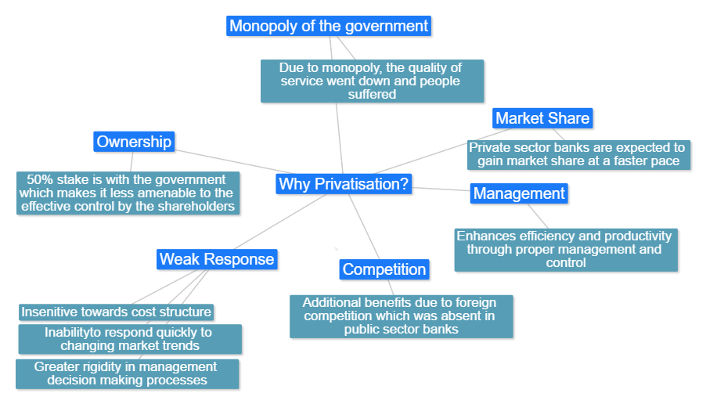
Why Privatization?

Slide 8
Impacts of Privatization
There was a great increase in the number of bank branches after privatization from 8262 to 45,898 nationwide
Branches in rural/semi-urban sectors increased from 2% to 40% after the privatization phase
Credits in agriculture increased from Rs.162 crore to Rs.4,46,496 crore
More job opportunities after privatization which leads to increase in staff from 2,20,000 to 9,65,720

Slide 9
Because of credit misallocation, public sector banks may be a bigger threat to stability than private banks
Private sector bank loans growth is faster as compared to public sector banks
There was a great increase in the efficiency of the private banks as the control over bank employees increases
Private sector banks provide many additional services to its customers to rise in competition

Slide 10
Adverse Impacts of Privatization
Interest rates are higher in private banks than in public banks
Private banks contribute to the global and nationwide recession
Private banks tend to be biased towards the more profitable sectors, hereby widening the gap between rich and poor
There is less job security in case of private banks
Interference and manipulation by the politician and industrialist is in full swing. In some cases, bank loans were used to garner votes
Due to minimal government control, private banks are free to use private recovering agencies to recover bad loans

Slide 11


Slide 12
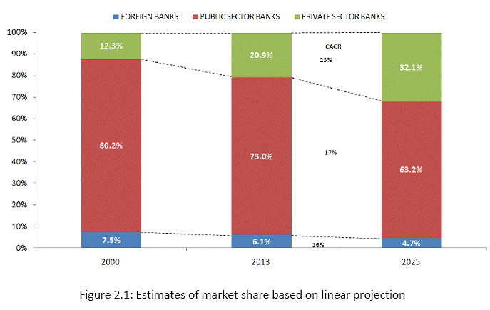
Predicting a linear growth based on the current growth rate

Slide 13
Conclusion
Based on the current statistics, Privatization shows no signs of receding in the next decade
Privatization has an overall positive impact in the economy, with a few adverse impacts
Nationwide debate over Privatization has made it influential in various sectors including banking, industries etc.
The influence of privatization is seen more in developed areas. However, it still needs to develop in rural areas
Not only the customers are benefitted, but privatization in banking sector has overall uplifted the economic growth and development

